Slide 1

Trucks Risk Assessment

Slide 2
PROBLEM STATEMENT
AZ National Trucking wants to ensure that all fleet drivers comply with transportation regulations, and specifically to minimize insurance risks. We aim to identify drivers whose risk factor met or exceeded a predetermined threshold and then recommend actions to remedy. ANT would also like to identify patterns between its truck data and geographic information to reveal actionable insights to enhance its decision-making

Slide 3
BUSINESS OBJECTIVES
Identify the most significant variables leading to higher risk factor for drivers and trucks to focus driver training and direct truck purchasing
Identify existing patterns and make appropriate changes to operations to reduce risk factor throughout commercial drivers' activities

Slide 4
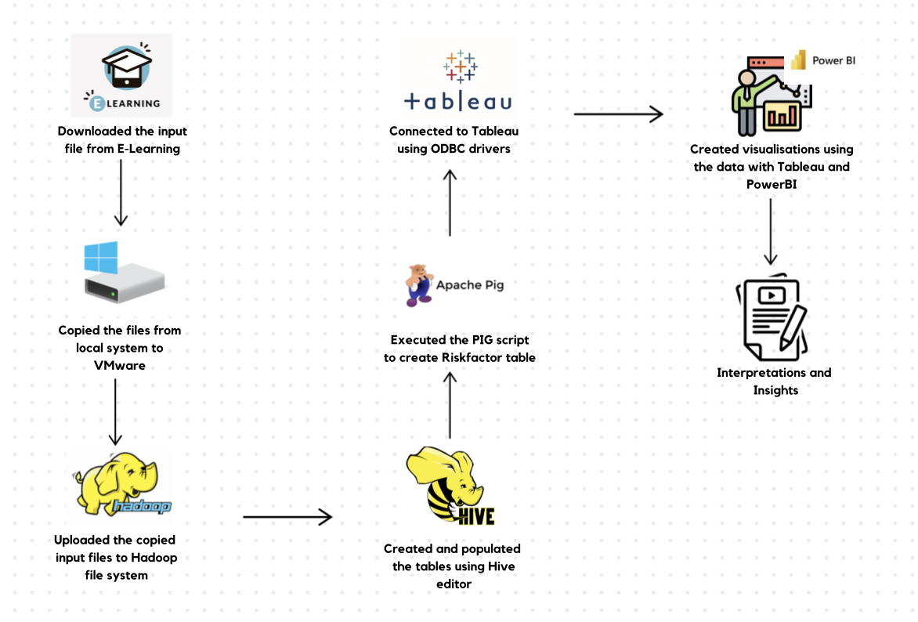
Workflow

Slide 5
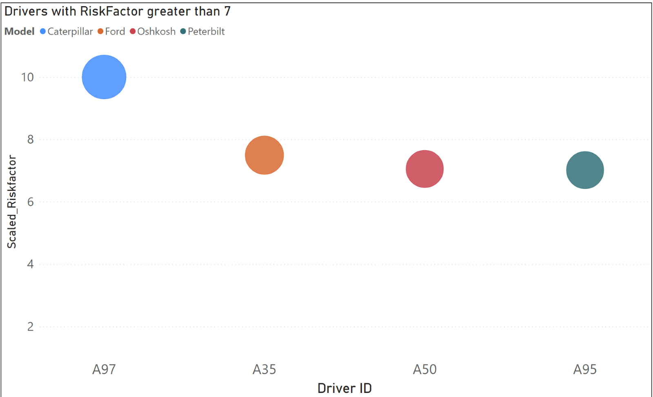
Notes:
Important point to mention before starting is that we scaled the risk factor values to the range between 1-10 using a MinMax Scaler as it doesn't disturb the original distribution
this graph has top 5 risky drivers who have riskfactor more than 7.

Slide 6
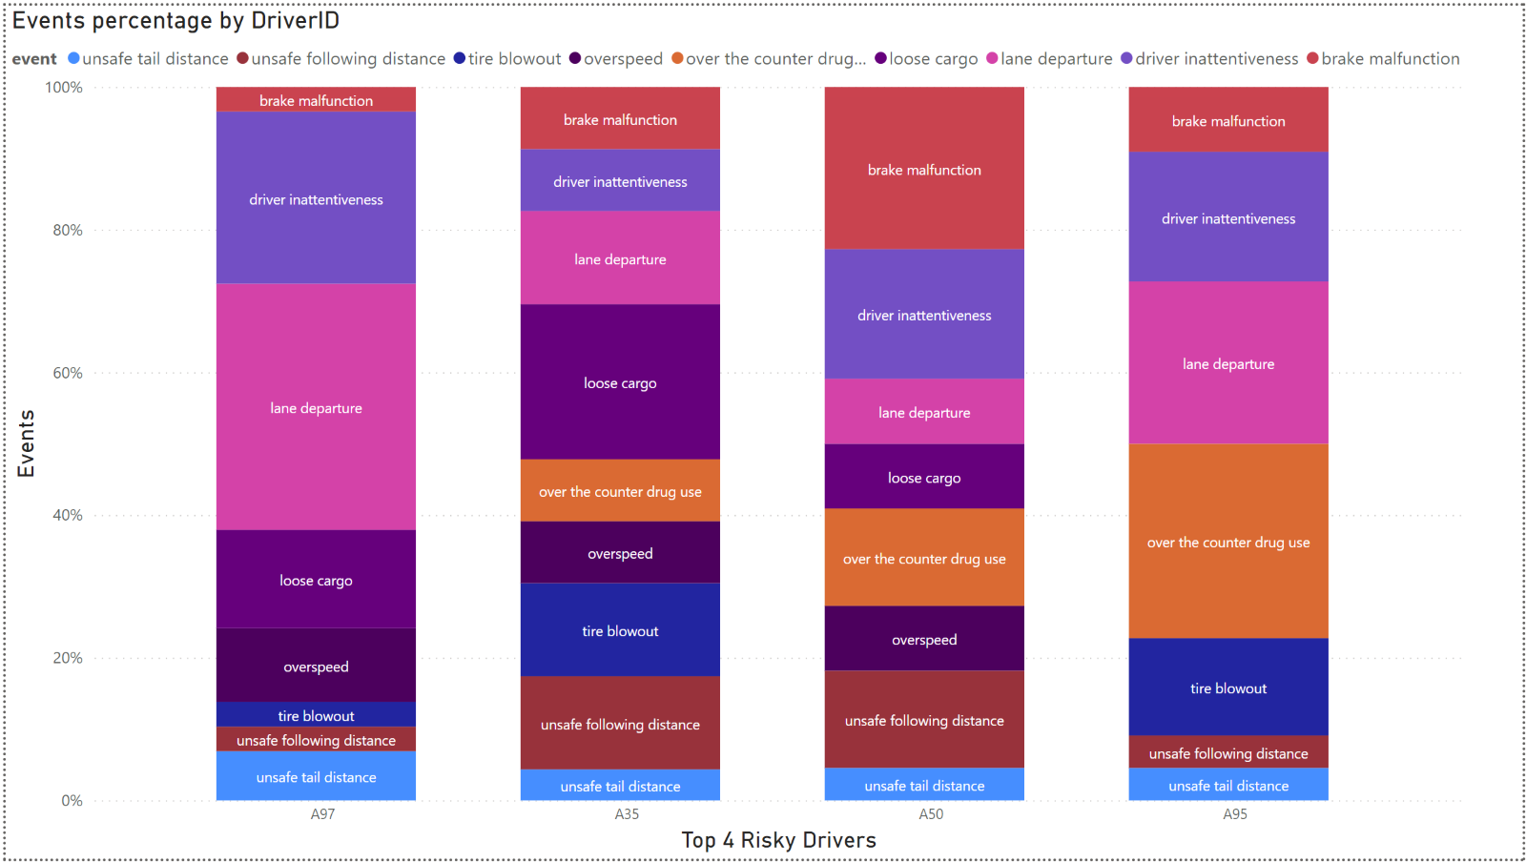
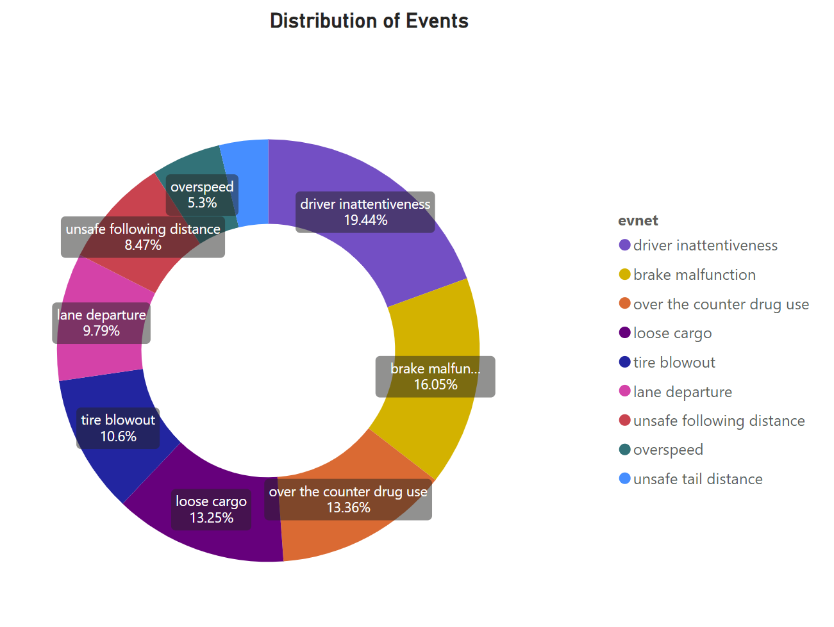
Notes:
the left graph is the event distribution for the top 5 risky drivers and right graph is the event distribution overall

Slide 7
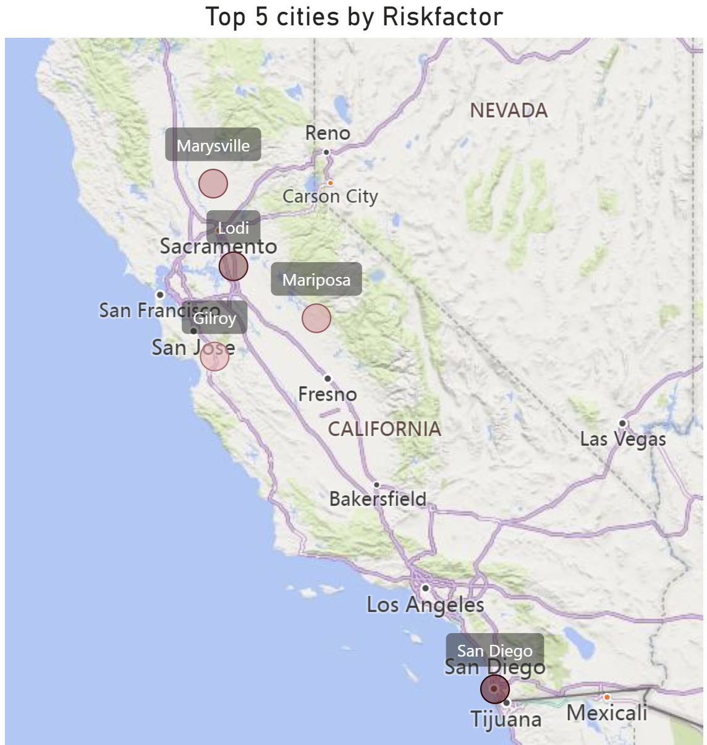
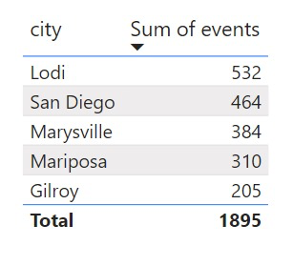
Notes:
top 5 risky cities based on average risk factor and on the right side we have a table for the number of events in those cities

Slide 8
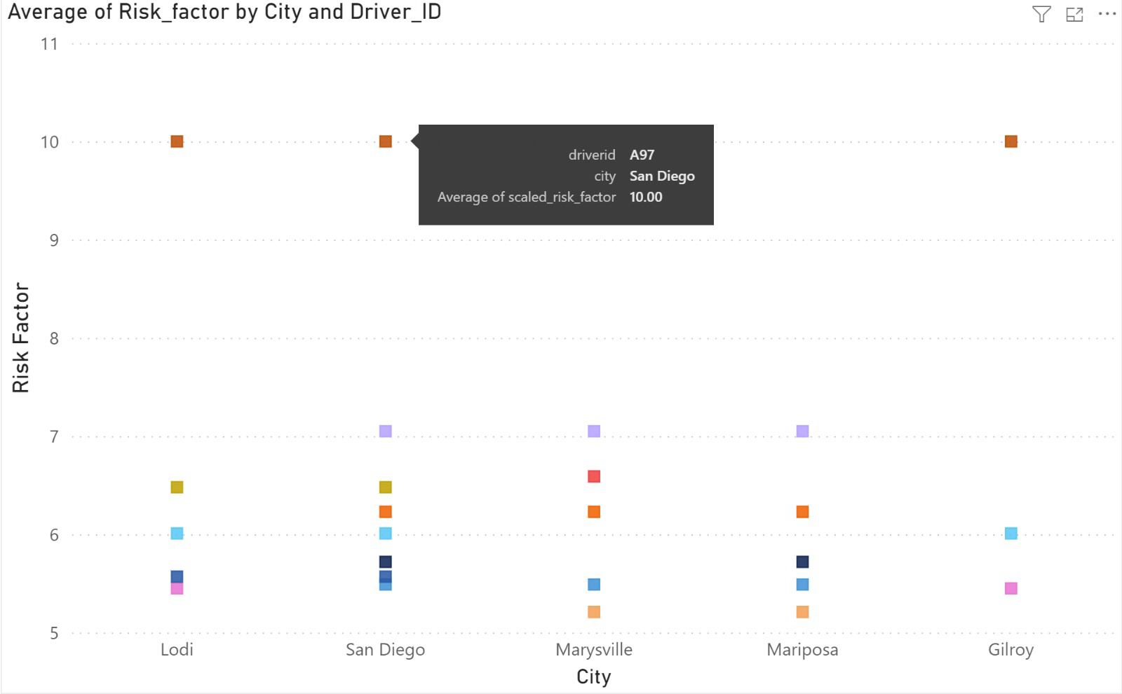
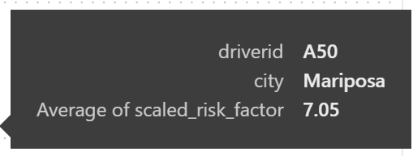
Notes:
in this graph we have taken the five riskiest cities which we found in the previous slide and checked who was the riskiest driver in those regions

Slide 9
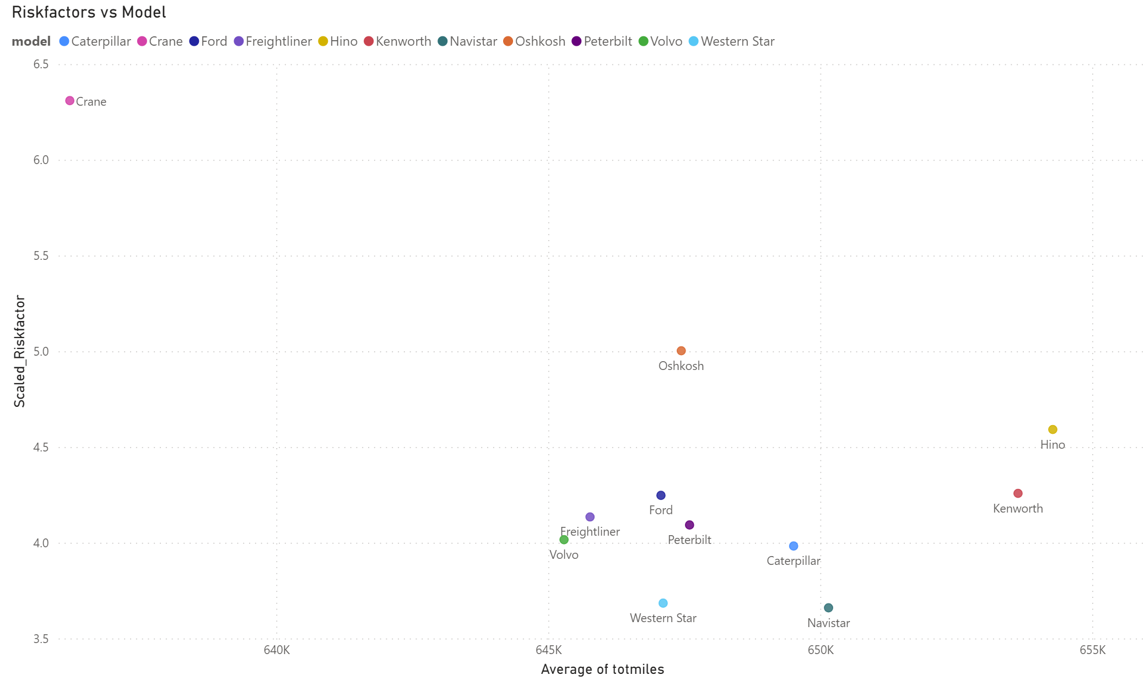
Notes:
this graph has the average risk factor for all the models

Slide 10
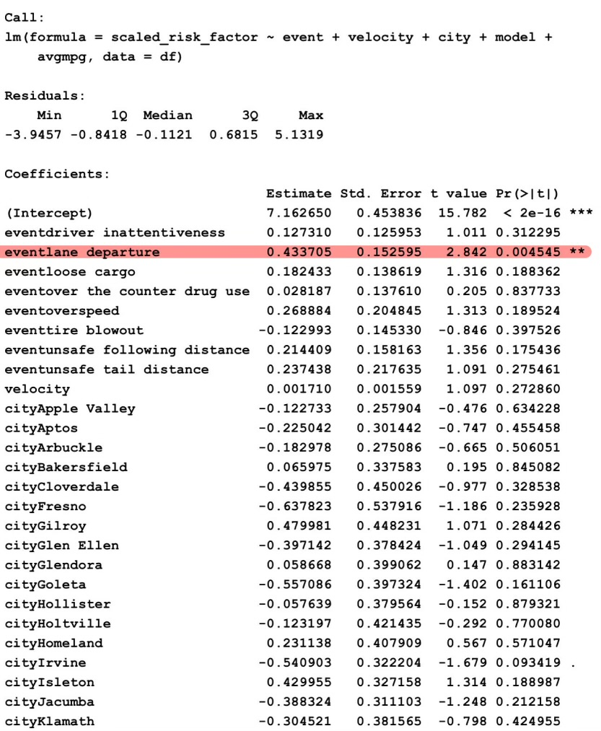
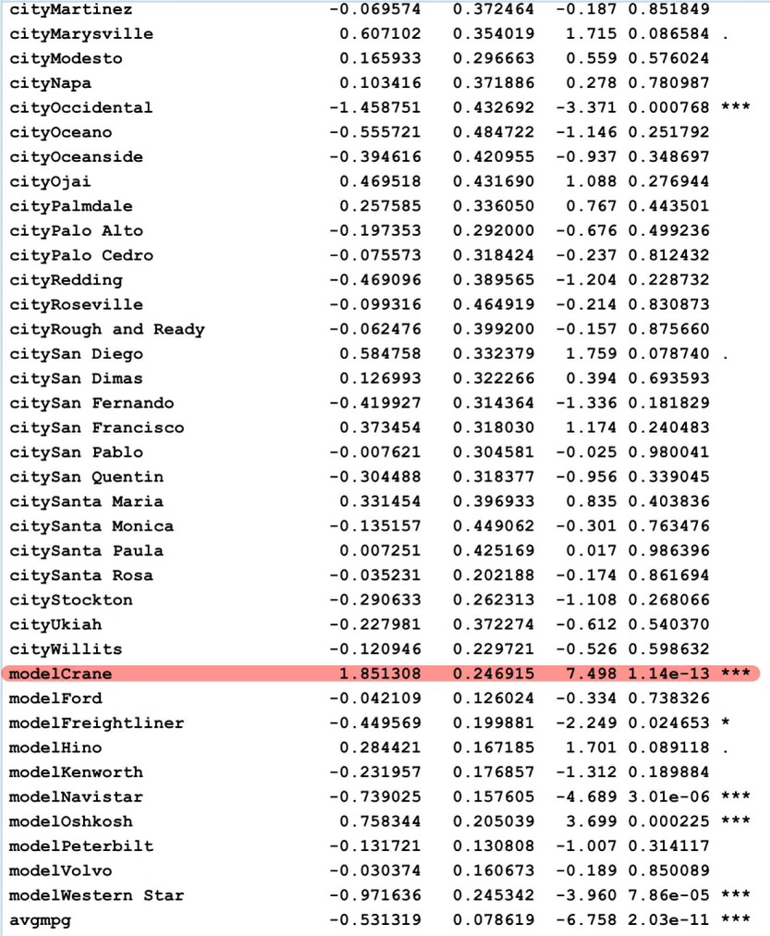
Analysis using R

Slide 11
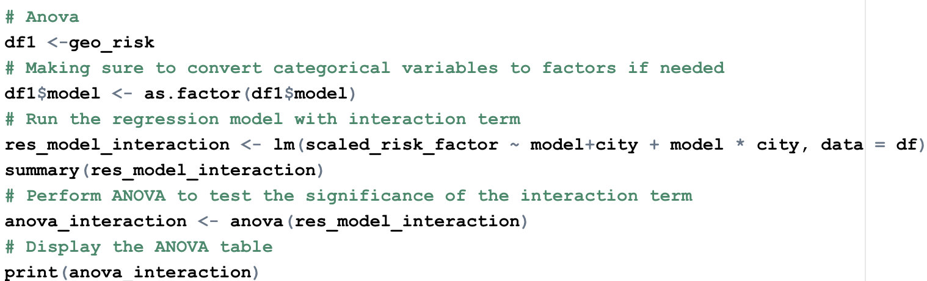
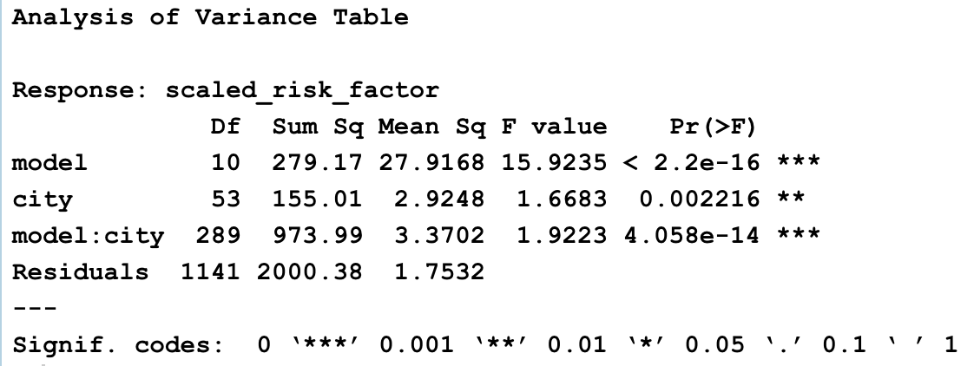
SYNERGY EFFECT | CANCELLATION EFFECT
PETERBUILT ~ HOMELAND | KENWORTH ~ GILROY
PETERBUILT ~ BAKERSFIELD | HINO ~ APTOS

Slide 12

Conclusions
A97 is the driver with highest

